Slide 1

RATING PREDICTION PROJECT BASED ON USER REVIEWS
PREPARED BY : G. PREMSAGAR

Slide 2

AGENDA
Introduction
Data Collection
Pre- Processing data with NLP
Model/s Development and Evaluation
Conclusion

Slide 3
INTRODUCTION
With firms fighting for customers' attention through aggressive marketing, internet reviews have become a crucial factor for consumers to consider. Over 88 percent of Ecommerce customers make purchases solely after reading product reviews. Customer journeys are secured by product ratings and reviews, which give them the confidence to continue the checkout procedure. Consumer insights may be gained through user-generated material. It aids Ecommerce sellers in comprehending the wants of their customers. Brands may utilize this data to come up with new product ideas, enhance and reinvent existing items, increase consumer loyalty, and grow their business.

Slide 4
DATA COLLECTION
Web scraping using Beautiful Soup & Selenium

Slide 5
DATA SOURCES AND THEIR FORMATS
We have a client who has a website where people write different reviews for technical products. Now they are adding a new feature to their website i.e. The reviewer will have to add stars(rating) as well with the review. The rating is out 5 stars and it only has 5 options available 1 star, 2 stars, 3 stars, 4 stars, 5 stars. Now they want to predict ratings for the reviews which were written in the past and they don’t have a rating.
So, we have to build an application which can predict the rating by seeing the review. On seeing the above problem definition, I have tried in building a successful machine learning model that will predict the rating based on the reviews given by the customer. But to train the model we require some data to play around. So, I have scraped some data from multiple ecommerce websites along with the ratting for the reviews. Web scraping or data collection is done with the help of Beautiful Soup and Selenium, and I have collected more than 50000 records with ratings and reviews and have stored in CSV format.

Slide 6
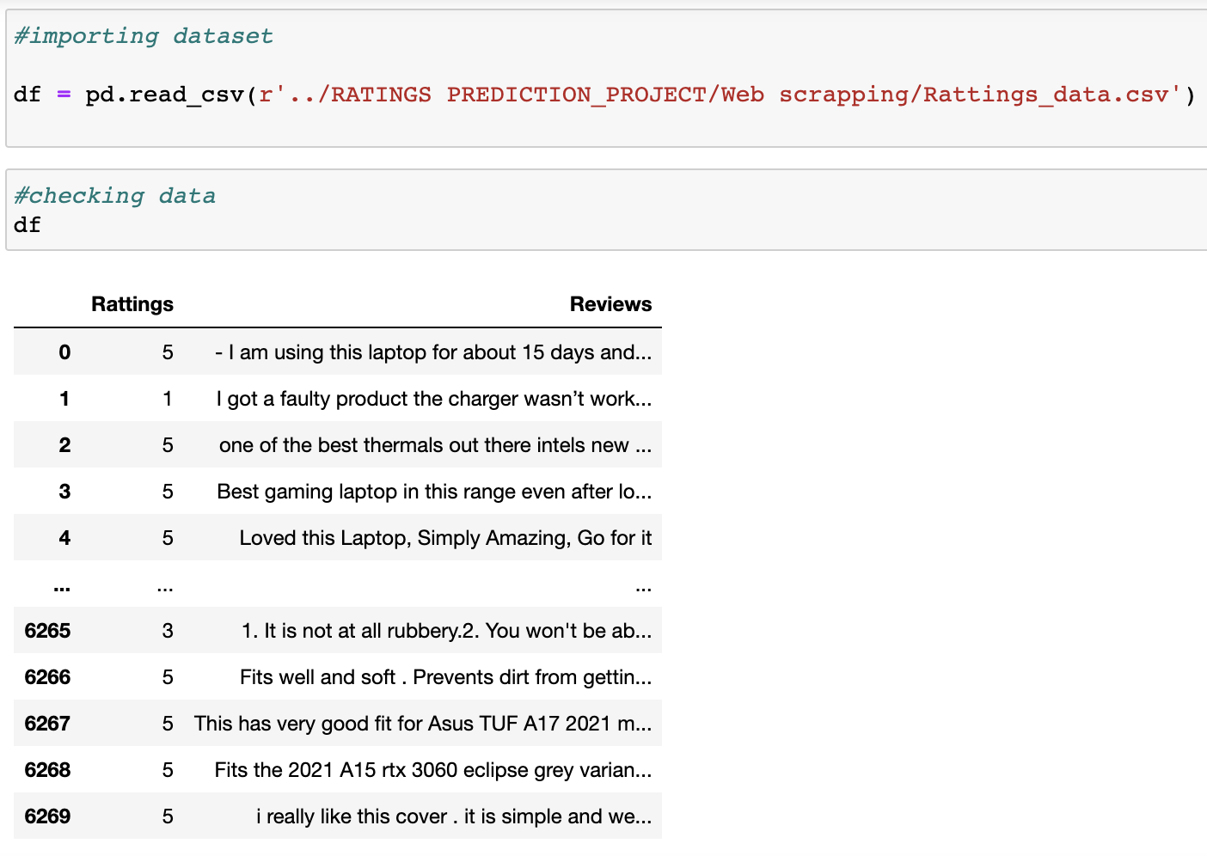
COLLECTED DATA

Slide 7
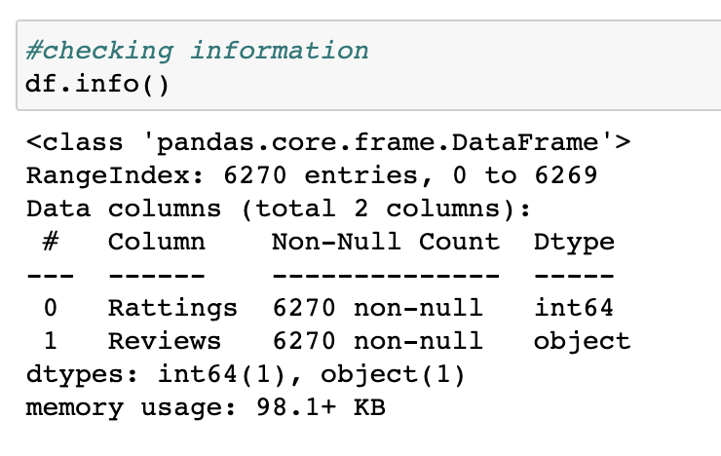
COLLECTED DATA

Slide 8
PRE- PROCESSING DATA WITH NLP
EDA with NLP

Slide 9

EXPLORATORY DATA ANALYSIS.
Exploratory data analysis is a statistical way of evaluating data sets to summaries their essential properties, frequently utilizing statistical graphics and other data visualization techniques.

Slide 10
EXPLORATORY DATA ANALYSIS.
STEP 1
Converting all the strings into lower case
STEP 2
Converting all the email address present in the reviews as “email address”.
STEP 3
Converting all the currency present in the reviews as “dollars”.
STEP 4
Converting all phone numbers present in the reviews as “phonenumber”. Have converted all the number present in the reviews as “number”.
STEP 5
Removed all punctuations and stop words and lemawords from the reviews.

Slide 11
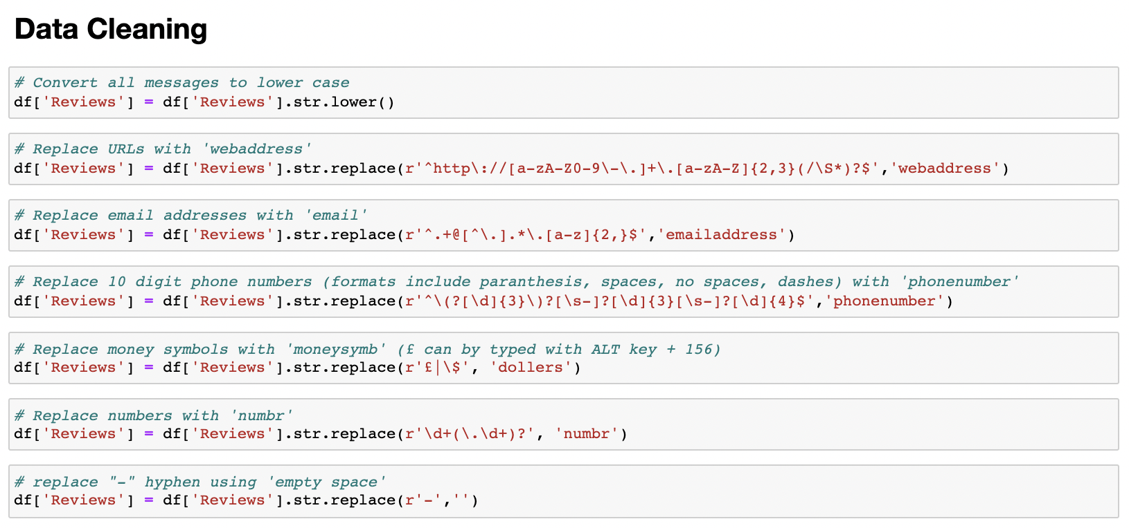
EXPLORATORY DATA ANALYSIS.

Slide 12
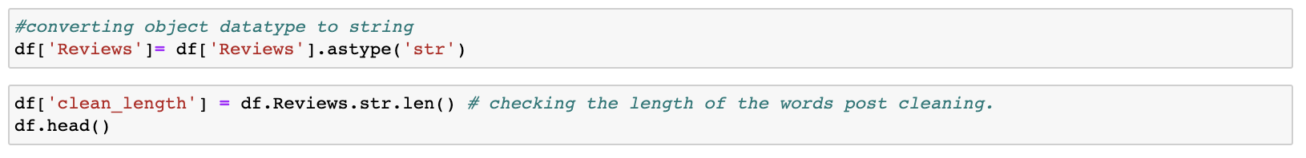
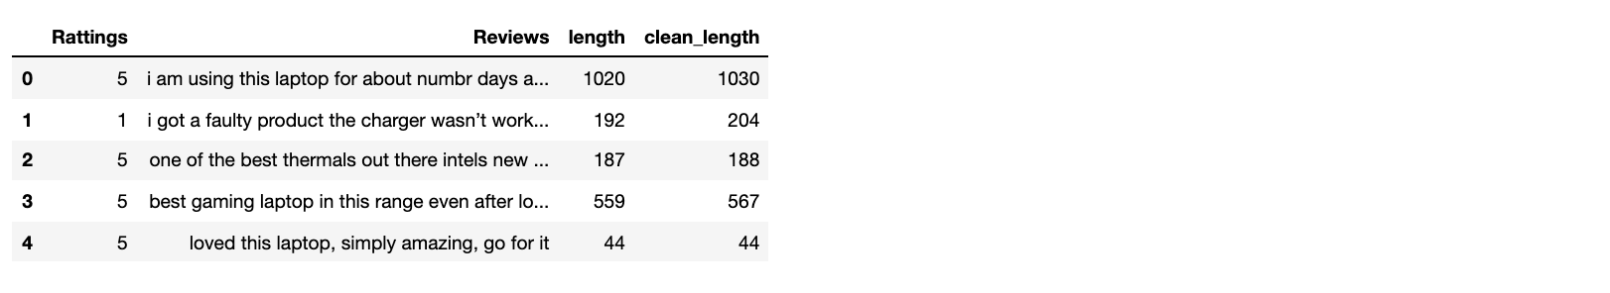
EXPLORATORY DATA ANALYSIS.

Slide 13
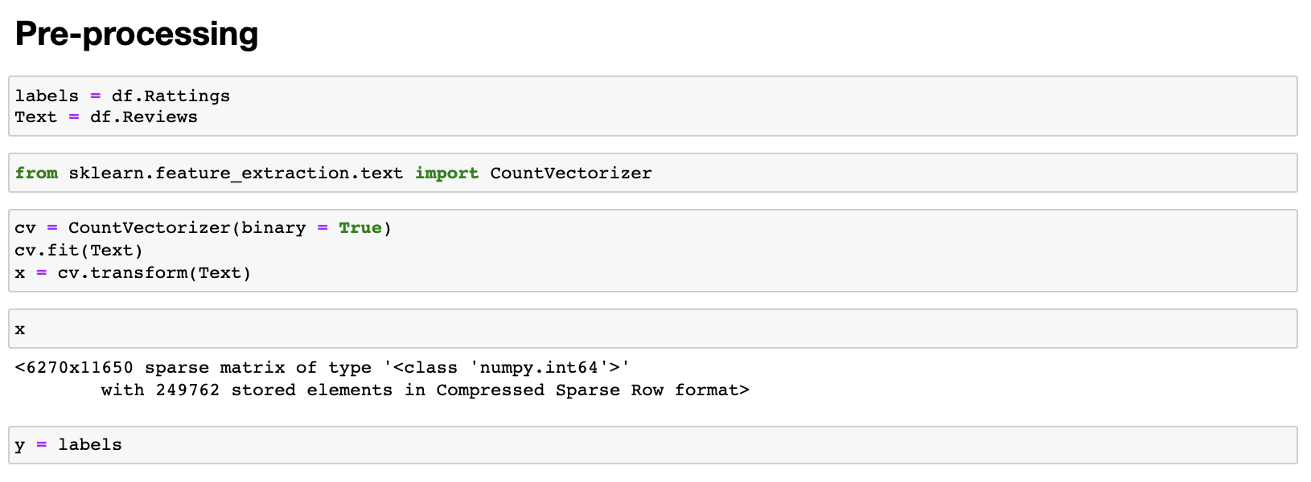
COUNT VECTORIZER FOR PREPROCESSING.

Slide 14
MODEL/S DEVELOPMENT AND EVALUATION
Logistic Regression
Naive Bayes Gaussian
Random Forest
Decision Tree
Extra Tree
Ada Boost
Gradient Boosting

Slide 15
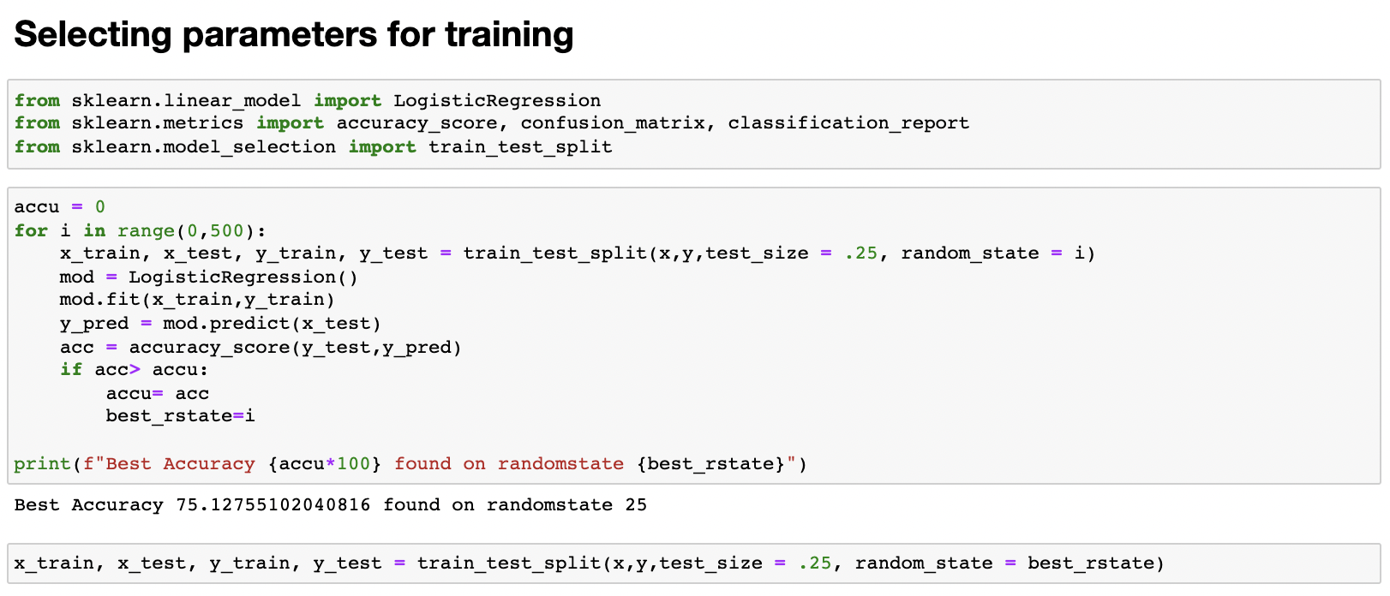
SELECTING BEST RANDOM STATE PARAMETERS FOR TRAINING.
With logistic regression I have created a loop between 0-500 to sort the best random state parameters with highest accuracy.

Slide 16
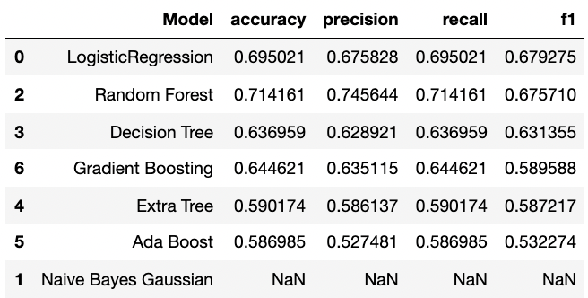
TESTING OF IDENTIFIED APPROACHES (ALGORITHMS).
I have used seven different algorithms and tried in sorting the top performed algorithm they are “Logistic Regression", "Naive Bayes Gaussian", "Random Forest", "Decision Tree", "Extra Tree", "Ada Boost", "Gradient Boosting".

Slide 17
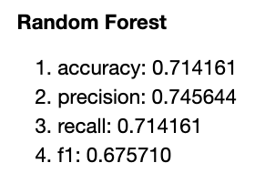
TESTING OF IDENTIFIED APPROACHES (ALGORITHMS).
From above table its evident that Random Forest Algorithm tops the chart which is further tuned and saved.

Slide 18
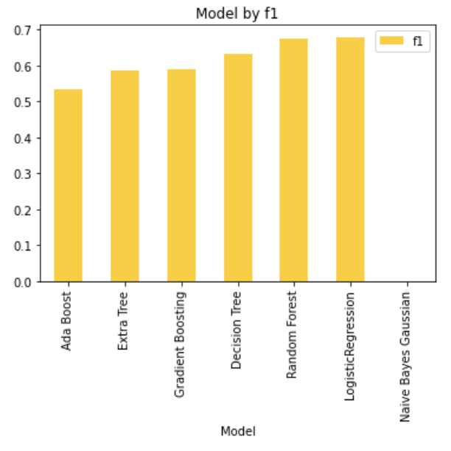
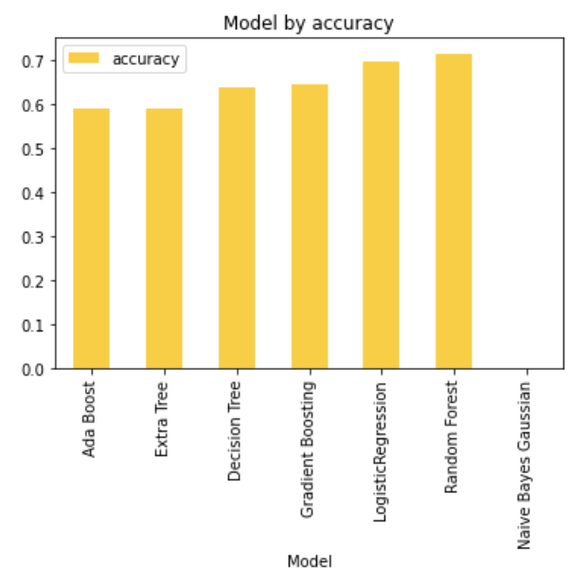
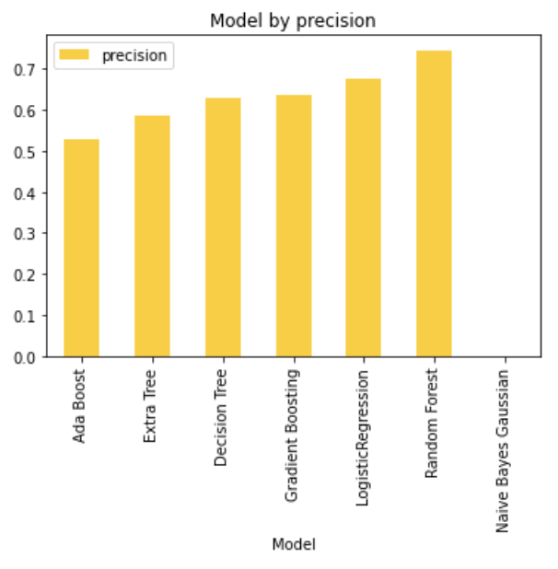
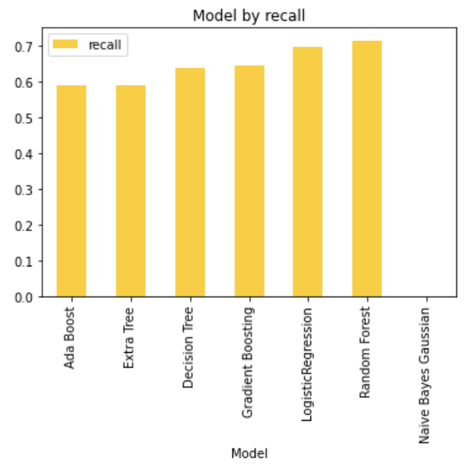
VISUALIZATION
As like said earlier I have trained using eight different models and finalized Random Forest as top performed model we are visualizing the metrics of these models.
Seeing the performance, I have finalized Random Forest model and hyper parameter tuned and saved the same.

Slide 19
CONCLUSION
In the digital era, online evaluations are a powerful word-of-mouth marketing tactic for offering outside viewpoints on products and services. While favorable evaluations can boost income and establish a trustworthy reputation, negative reviews, or the lack thereof, can have the opposite effect. Understanding the value of reviews and how to use them to help your business may be a crucial part of getting ahead in the competitive ecommerce industry and putting yourself miles ahead of the competition.

Slide 20


